Slide 1
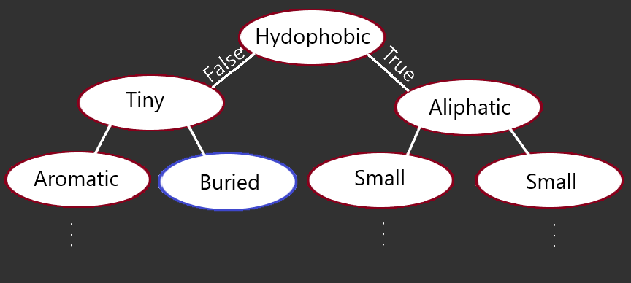

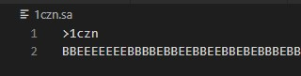
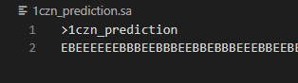
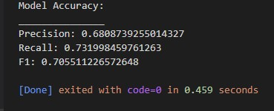

Sam Gass
Training:
Classification:
Visual of Model
From Command Line:
Actual Classification:
Predicted Classification:
Model Accuracy:
Percent Similar:

